Slide 1
JavaScript API’s
*Raise your hand if you’re scared. It’s OK.

Slide 2
JavaScript API’s
Drag and Drop, Canvas, Web Sockets would just be useless without JavaScript.
It turns out there is a spec for just that.

Slide 3


Slide 4
Agenda
Geolocation
Canvas <3
Web Workers and Web Sockets
Web Storage and Indexed DB
Drag and Drop
History API

Slide 5

Geolocation*
*It’s not creepy, just tell me where you are this exact moment.
Notes:
Though not “technically” part of the HTML5 specification, it’s hard not to bring Geolocation to the party because it’s another example of the richness and interactivity coming to web applications.

Slide 6
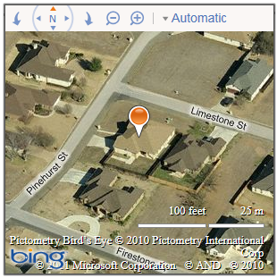
You are here (give or take 100 meters)
//Get my location, and put it on a map
navigator.geolocation.getCurrentPosition(function(position) {
var location = new Microsoft.Maps.Location(
position.coords.latitude,
position.coords.longitude);
_map.setView({ zoom: 18, center: location });
var pin = new Microsoft.Maps.Pushpin(location);
_map.entities.push(pin);
}, errorHandler);
Notes:
If you have a smartphone, you’ve no doubt used Geolocation provided to apps by your device. With Geolocation support in all major browsers, desktop and mobile web applications can support Geolocation as well. Here, we’re retrieving the user’s current location and using the result to populate a map.
[Images captured from my computer]

Slide 7






Browser Support for Geolocation
 |  |  |  |  | Mobile
9 | 5 | 3.5 | 10.6 | 5 | 10 | 2.1 | 3.2
Notes:
The good news is you can fall back to using IP address in older browsers (plus an external geo-ip service)

Slide 8
Geolocation
demo
Notes:
Now let’s quickly add Geolocation (with fallback and graceful degradation) to our site.
http://ie.microsoft.com/testdrive/HTML5/Geolocation/Default.html

Slide 9

Canvas*
*Arts and crafts time!
Notes:
Now let’s look at Canvas and SVG, two graphics technologies for the web.
http://www.cuttherope.ie/

Slide 10
<canvas> + JavaScript = Pretty Much Anything
var canvasContext = document.getElementById("canvas")
.getContext("2d");
canvasContext.fillRect(250, 25, 150, 100);
canvasContext.beginPath();
canvasContext.arc(450, 110, 100,
Math.PI * 1/2, Math.PI * 3/2);
canvasContext.lineWidth = 15;
canvasContext.lineCap = 'round';
canvasContext.strokeStyle = 'rgba(255, 127, 0, 0.5)';
canvasContext.stroke();
Notes:
You can think of the canvas element, just like it sounds: a blank drawing surface embedded in your page. Adding <canvas> is as simple as adding the canvas tag, but you manipulate the canvas from JavaScript, where you can add shapes, text, images, gradients, transformations, effects and even animation. The canvas element is a pixel-based drawing surface.
Remember how I said JavaScript was important? Without it, all you can do with Canvas is put an element on the page. You need JavaScript to manipulate it. In this slide, we’re selecting the 2d context of the canvas, adding a rectangle, then adding a orange arc with rounded corners to the canvas.
In many ways, the Canvas is a scriptable Image tag, which is a powerful concept.
fillRect(x, y, width, height);
arc(x,y, radius, startAngle, endAngle, anticlockwise [optional bool]);

Slide 11
Browser Support for Canvas
 |  |  |  |  | Mobile
9 | 4 | 2 | 9 | 3.1 | 10 | 2.1 | 3.2
Notes:
Remember though that FlashCanvas brings canvas “polyfill” support to IE 8

Slide 12
<canvas>
demo
Notes:
Let’s take a look at canvas and svg in action.
http://kennethjorgensen.com/canvas/tree.html
http://www.mrspeaker.net/dev/parcycle/
https://developer.mozilla.org/en-US/demos/detail/zen-photon-garden/launch

Slide 13
Web Workers and Sockets*
*Because together we can make JavaScript far more difficult to use than it already is.
(Actually, it’s not that bad!)

Slide 14

Web Workers

Slide 15
Web Workers
var worker = new Worker('doAwesome.js');
worker.addEventListener('message', function(e) {
console.log('Worker said: ', e.data);
}, false);
worker.postMessage('Hello World');

Slide 16
Web Workers
doAwesome.js
self.addEventListener('message', function(e) {
self.postMessage(e.data);
}, false);

Slide 17
Browser Support for Web Workers
 |  |  |  |  | Mobile
10 | 4 | 3.5 | 10.6 | 4 | 10 | 4.4 | 5

Slide 18
Web Sockets – Real Time Connections
var socket = new WebSocket('ws://my.websocket.org/echo');
socket.onopen = function(event) { socket.send('Hello, WebSocket'); };
socket.onmessage = function(event) { alert(event.data); } socket.onclose = function(event) { alert('closed'); }
Client
HTTP
Server
TCP
Notes:
Web Sockets are a Full-duplex, bi-directional communication over the Web: Both the server and client can send data at any time, or even at the same time. Only the data itself is sent, without the overhead of HTTP headers, dramatically reducing bandwidth.
Web Sockets has been the subject of a lot of press and debate due to its early inclusion and subsequent removal from some browsers, but the technology isn’t gone. In fact, it’s being actively worked on by two standards bodies as we speak. Microsoft has published several updates to our demo Web Sockets implementation, and continues to update the demo with each publication of the specification. Try it out for yourself at HTML5Labs.com
Web sockets are accessed through the WebSocket object. Sites open a socket at an end point, send messages and respond to new messages.
Socks.js
Socket.io
Engine.io
signalR

Slide 19
Browser Support for Web Sockets
 |  |  |  |  | Mobile
10 | 14 | 6 | 11p | 5 | 10 | 4.4 | 4.2

Slide 20
Workers and Sockets
Demo
– but not yet
Notes:
Workers
http://www.html5rocks.com/en/tutorials/workers/basics/
http://ie.microsoft.com/testdrive/HTML5/WebWorkerTest262/Default.html
WebSockets
http://html5labs.interoperabilitybridges.com/prototypes/websockets/websockets/info
http://html5labs.cloudapp.net/WebSockets/ChatDemo/wsdemo.html

Slide 21
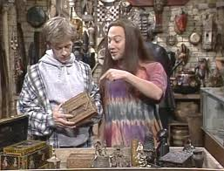
Storage and IndexedDB*
*You put your … in it.
Notes:
Next up, storage. Who still fights with cookies on their sites? HTML5 introduces a new key/value storage mechanism often referred to cookies on steroids. They’re not cookies, though, because you have more space for local storage (up to 5mb), and the storage items are not transferred back to the server on each request, as cookies are, so using them wont slow down your site.

Slide 22
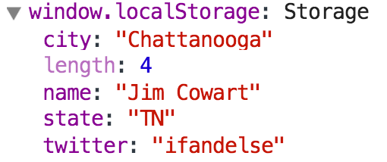
Working with localStorage
$('#save').click(function () {
window.localStorage.setItem('name',$('#name').val());
window.localStorage.email = $('#email').val();
});
$('#name').val(window.localStorage.getItem('name'));
$('#email').val(window.localStorage.email);
Notes:
Local storage is targeted at providing you the developer with a way to capture and store user-specific data in the users browser, without transmitting that information back to the server. These things are scoped only to a domain, and live beyond the browser session, meaning you can pull and use them long after the user leaves the site. Note, as in the example here, that you can access localStorage both via getItem and setItem functions, or access the value directly using the key.
Local storage is supported in all major browsers, and has support in IE in versions 8 AND 9. What’s more, if you want to adopt Storage more broadly, there are polyfilling options that enable you to use localStorage all the way back to IE5.
5.1k characters of text in local storage

Slide 23
Browser Support for Web Storage
 |  |  |  |  | Mobile
8 | 4 | 3.5 | 10.5 | 4 | 9 | 2.1 | 3.2

Slide 24
Working with IndexedDB
var request = indexedDB.open(”MyDB", version);
request.onsuccess = function (e) {
var db = e.target.result;
// Do something with db now….
db.transaction(["prefs"])
.objectStore("prefs")
.index("fullName")
.openCursor(
IDBKeyRange
.only(name)).onsuccess =
getIterator(self,prefs,"prefs.filtered");
};
Notes:
IndexedDB is a W3C draft specification for the storage of large amounts of structured data in the browser, using indexes that allow for high performance searches on this data.
It's a key/value store. Values can be objects, and keys can be a property of those objects.
It uses a transaction model - so each operation is tied to a transaction, including reads. (There are three transaction modes: read-only, read/write, and versionchange)
You can create indexes (using any of the properties on the stored objects) for searching and sorting.
The spec defines an asynchronous and synchronous API, though no major browser has implemented the synchronous version yet.
Firefox currently allows a site to use up to 50MB
IE 10 will allow up to a whopping 250MB
One dev got Chrome to 400MB before it crashed….

Slide 25
Browser Support for IndexedDB
 |  |  |  |  | Mobile
10 | 11 | 4 | 17 | ? | 10 | 4.4 | ?

Slide 26
Local Storage & IndexedDB
demo
Notes:
Let’s take a look at leveraging localStorage by adding the capability of saving user preferences locally in the browser, and then loading those. [Be ready to speak to security of these items (sandboxed to site, etc.)].
Local Storage
http://jsfiddle.net/ifandelse/NPKUJ/light/
IndexedDB
http://jsfiddle.net/ifandelse/f5mNW/light/

Slide 27
Drag and Drop*
*Because if you can’t drag it, it sucks.

Slide 28
Using Drag and Drop
Make it draggable
Implement the events

Slide 29
Using Drag and Drop
< li draggable="true“>
DnD Events
dragstart
dragenter
dragover
dragleave
drop
dragend
Notes:
Dragstart - Fired on an element when a drag is started.
Dragenter - Fired when the mouse is first moved over an element while a drag is occurring. A listener for this event should indicate whether a drop is allowed over this location.
Dragover - This event is fired as the mouse is moved over an element when a drag is occurring.
Dragleave - This event is fired when the mouse leaves an element while a drag is occurring.
Drop - The drop event is fired on the element where the drop occurred at the end of the drag operation.
Dragend - The source of the drag will receive a dragend event when the drag operation is complete, whether it was successful or not.

Slide 30
Using Drag and Drop
Draggable Element
dataTransfer Object
“Droppable” Target Element
Notes:
The target “droppable” element would need a listener for a dragover and/or dragenter event and indicate in the handler whether or not a drop is allowed
The DataTransfer object is used to hold the data that is being dragged during a drag and drop operation.

Slide 31
Browser Support for Drag and Drop
 |  |  |  |  | Mobile
5.5 | 4 | 3.5 | 12 | 3.1 | 10 | ☹ | ☹

Slide 32
Drag and Drop
demo
Notes:
http://ie.microsoft.com/testdrive/HTML5/CORSUpload/
https://developer.mozilla.org/ms/demos/detail/crop-puzzle/launch

Slide 33
History API*
*It’s like #!, only completely different and not hideous.

Slide 34
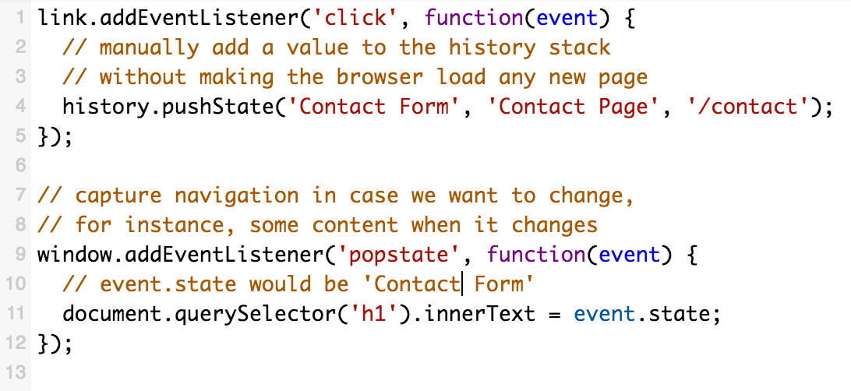
History API
Notes:
The DOM window object has always provided access to the browser’s history through the “history” object. It exposes methods like back, forward and go to allow script-based navigation.
pushState(data, title, url) // data is structured clone so it can be an object or string, etc.
HTML5 introduced the history.pushSate() and history.replaceState() methods, which allow you to add and modify history entries. The code above will actually change the address bar to “/contact”, but it won’t cause the browser to load the “contact” route, or even check that it exists. In essence, the History API means that the back button is no longer broken when using AJAX!
FF currently ignores the title param (#2)
The popstate event is fired when the active history entry changes. If the history entry being activated was created by a call to history.pushState() or was affected by a call to history.replaceState(), the popstate event's state property contains a copy of the history entry's state object.

Slide 35
Browser Support for History API
 |  |  |  |  | Mobile
10 | 5 | 4 | 11.5 | 5.0* | 10 | 2.3* | 5
Notes:
PARTIAL support in Safari 5+
Android support in 2.2 and 2.3, then again in 4.2+

Slide 36
Want More? Download the Labs!
Clone the Labs repo from https://github.com/ifandelse/HTML5Workshop
Go to http://bit.ly/1gaNDZn and follow the instructions from the readme
Alternatively, open readme.md in the “JavaScript_Lab” folder

Slide 37
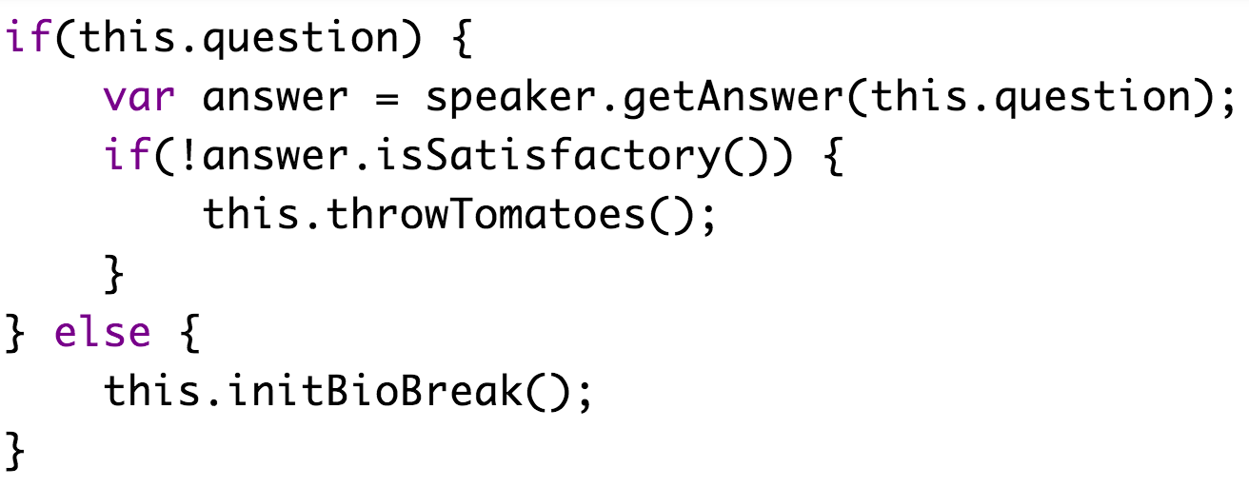
Questions?

